Slide 1
Covid 19 Prediction
By Aarush Mathur
CMSE 801

Slide 2
Some Facts
COVID-19 (coronavirus disease 2019) is a disease caused by a virus named SARS-CoV-2 and was discovered in December 2019.
It is very contagious and has quickly spread around the world.
Common symptoms of COVID-19 include a fever, cough, congestion, and shortness of breath, chills, muscle aches, and loss of taste or smell.
People who have chronic health issues or compromised immune systems, such as heart disease, lung disease, or diabetes, are at a greater risk of becoming seriously ill.

Slide 3
METHODS
Prediction of disease spread using “polyfit” function.
Demonstrating the spread of covid in lower to higher density regions using Agent Based Modelling.

Slide 4
Project Motivation
To predict how Covid19 will spread without the use of vaccine.
To show it spreads faster in higher population density regions.

Slide 5
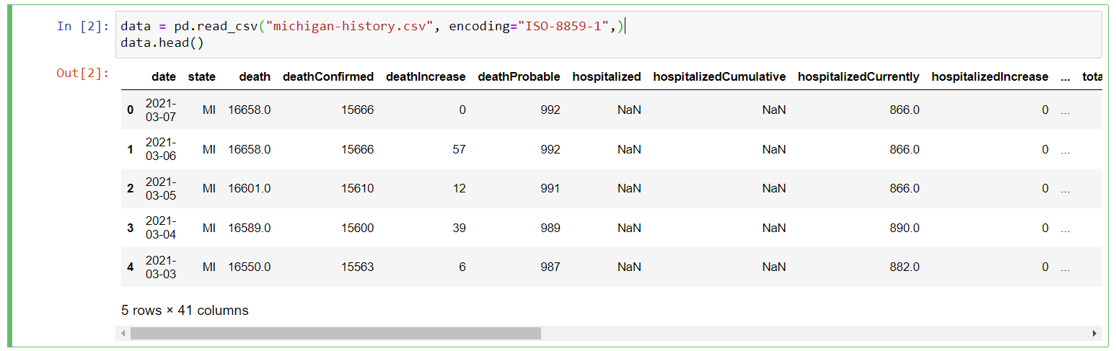
Reading csv File

Slide 6
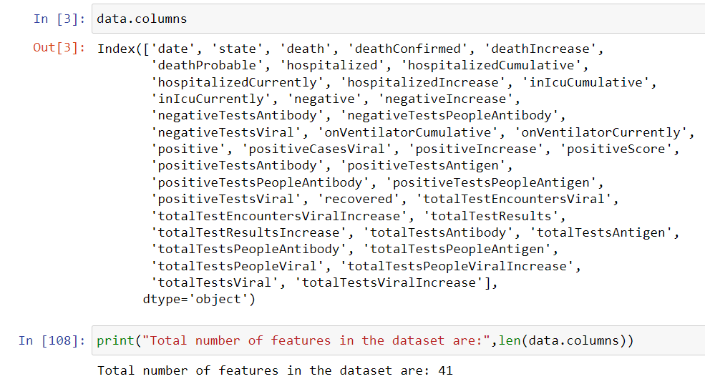
Dataset Overview
The dataset is provided by this website:
https://covidtracking.com/data/state/Michigan.
There are 41 features in this dataset.

Slide 7
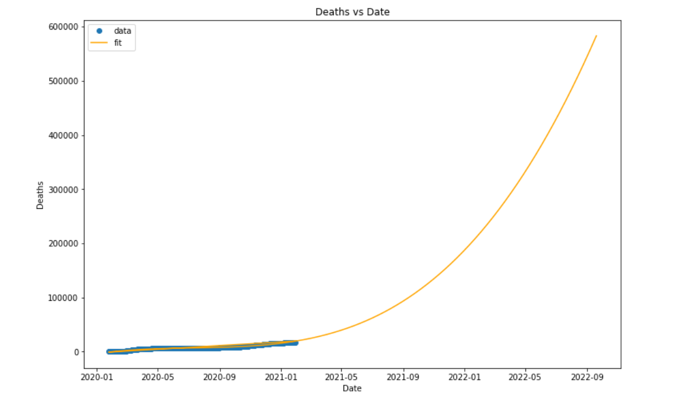
Future Prediction of Covid
Figure 1. This figure shows us the Death vs Date data with the given data till the beginning of 2021 and then predicted data till the end of 2022.

Slide 8
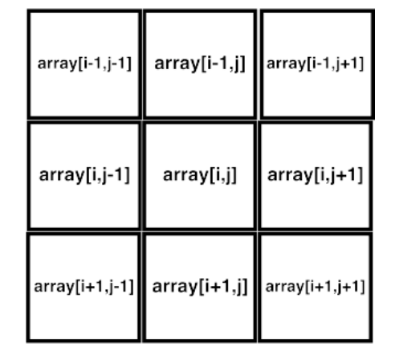
Moore Neighbourhood
We have used Moore Neighbourhood in our project because it is a true depiction of the spread of a disease.

Slide 9
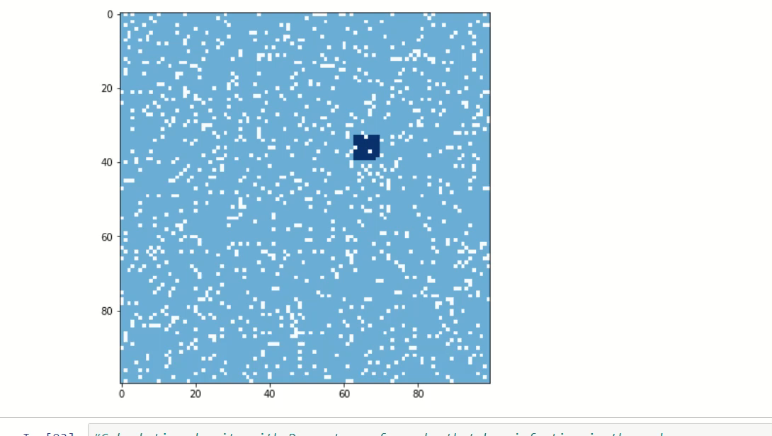
Animation of spread of Covid Infection

Slide 10
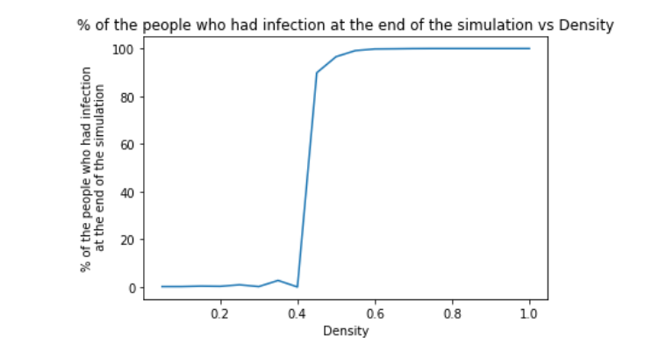
Results
Figure 2. This figure shows us the Percentage of the people who had infection at the end of the simulation vs Density.

Slide 11

List of Libraries used
import pandas as pd
import matplotlib.pyplot as plt
import numpy as np
import datetime
from datetime import timedelta
import time
import random as random
from IPython.display import display, clear_output

Slide 12
Conclusion
Our project predicts the spread of Covid in the future but it does not take under consideration, the effects of vaccination.
Our prediction follows third-order polynomial.
It also shows how the effect of a disease spread with increase in the density.

Slide 13
Thank You!!

